Slide 1


Team Name
Model_monkeys
Team Leader
Priyanka P
Problem Statement
Political rallies, festivals, sports events, construction activities, and sudden gatherings create localized traffic breakdowns.

Slide 2

Team Members
Team Leader
Priyanka P
M Kumarasamy College of Engineering
Team Member 1
Kishore Karthikeyan
M Kumarasamy College of Engineering
Team Member 2
Harikrishna K S
M Kumarasamy College of Engineering
Team Member 3
Lokesh Kumar S
M Kumarasamy College of Engineering

Slide 3
Opportunity & Unique Selling Proposition
insightsProactive Command
The Flaw in Existing Tools
Existing apps (like Google Maps) only show gridlock after it happens. We predict it beforehand.
Command vs. Commuter
Not just a navigation map our solution is a dedicated Digital Twin Command Grid built specifically for municipal traffic operators.
auto_awesomeUnique Selling Proposition
Explainable AI (XAI)
Eliminates the AI "black box." Uses the SHAP framework to show officers exactly why an AI decision was made.
Instant SOP Generation
An integrated Llama 3 model translates complex traffic data into plain-text, actionable steps for units on the ground.

Slide 4
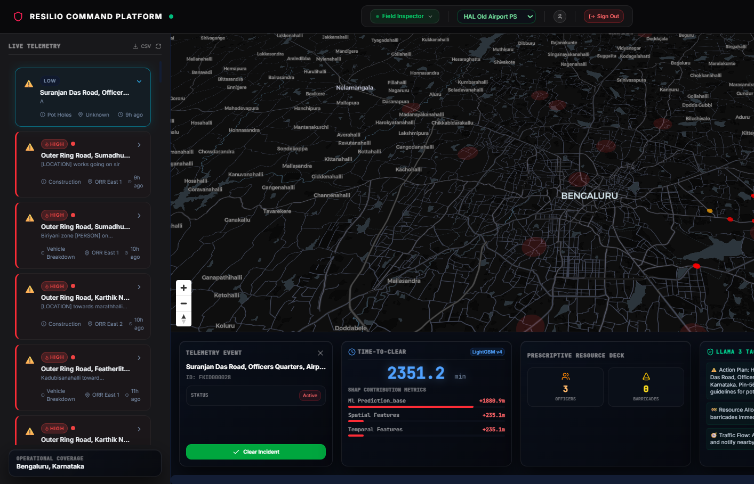
Key Platform Features
01. Predictive Sandbox
Simulates live vehicle and footfall surges based on ASTraM telemetry to forecast gridlock before it happens.
02. Priority Routing
Automatically maps tactical bypass corridors to keep mass transit moving during peak congestion.
03. Explainable AI
Uses SHAP metrics to transparently reveal exactly why a routing decision was made by the system.
04. SOP Synthesis
Translates complex data into clear, step-by-step text commands for field officers on the ground.
05. Hardened Security
Municipal infrastructure with JWT auth, bcrypt hashing, and Pydantic-validated data schemas.

Slide 5
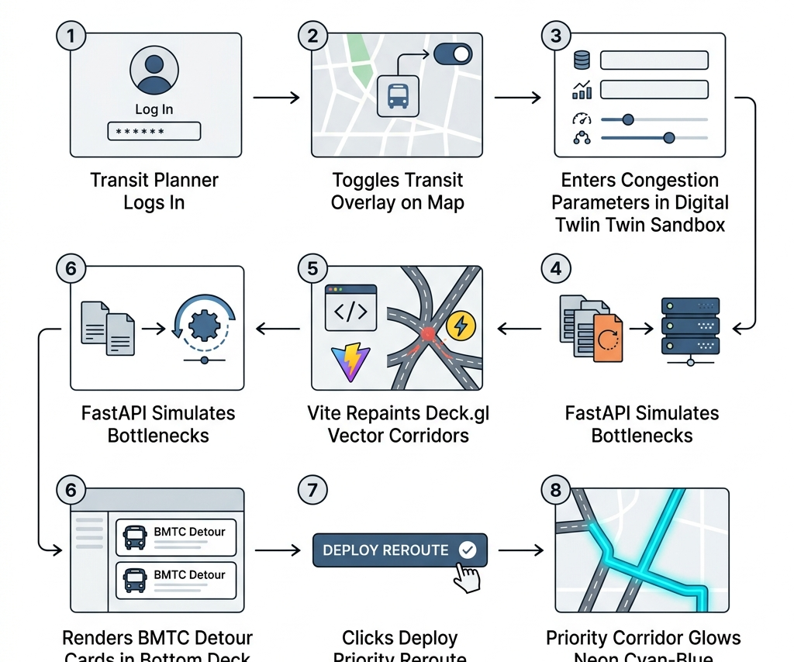
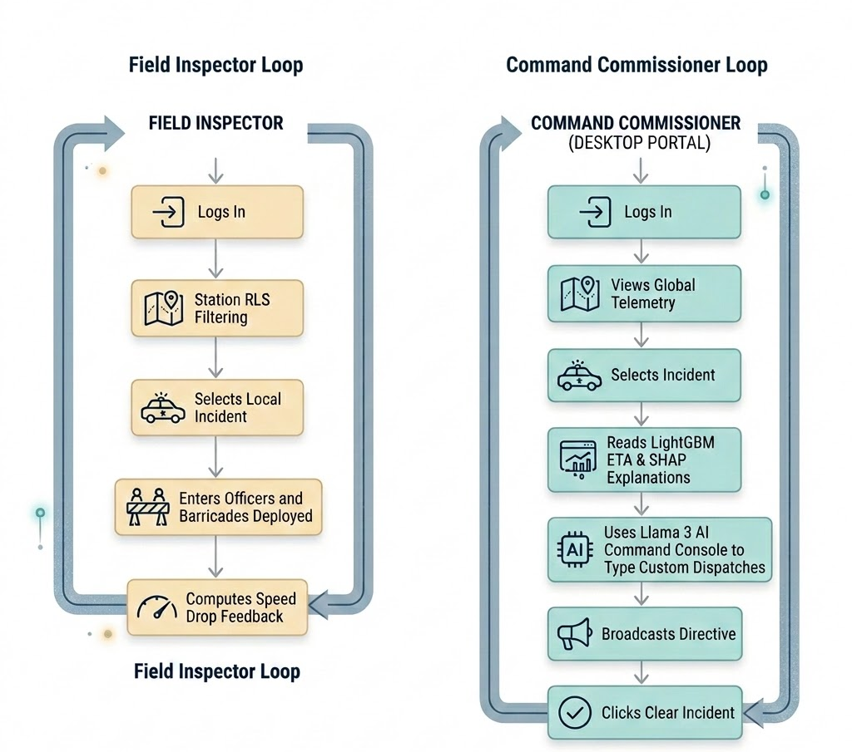
Workflow & Operational Execution
The 'RESILIO Platform User Workflow
Human-Approved Command Commissioner Loop

Slide 6
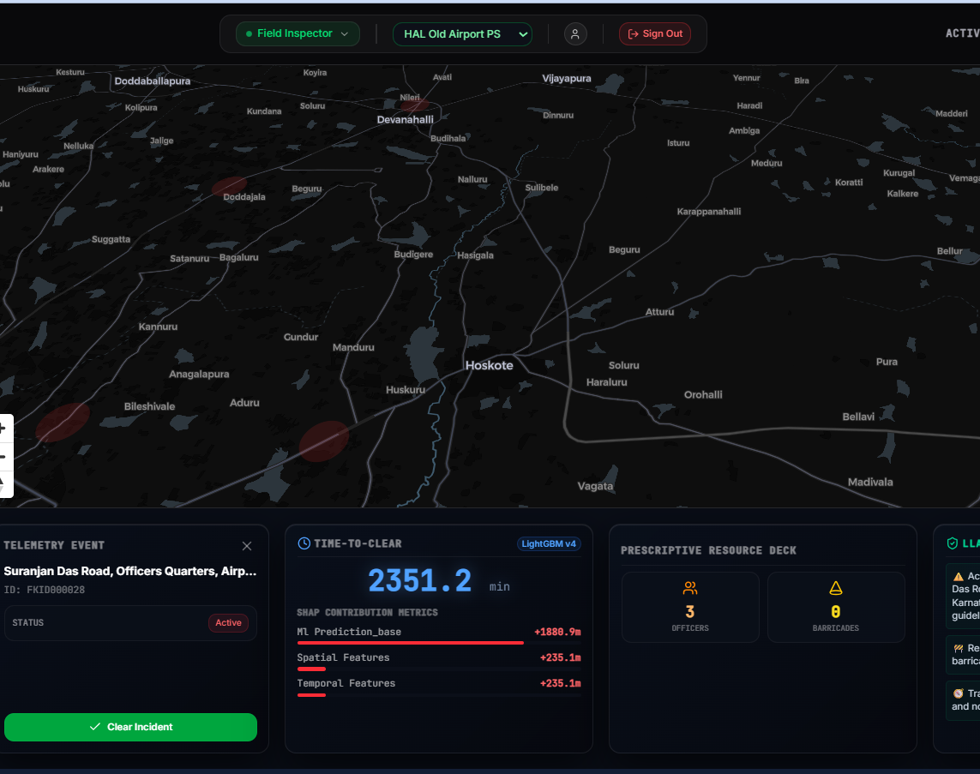
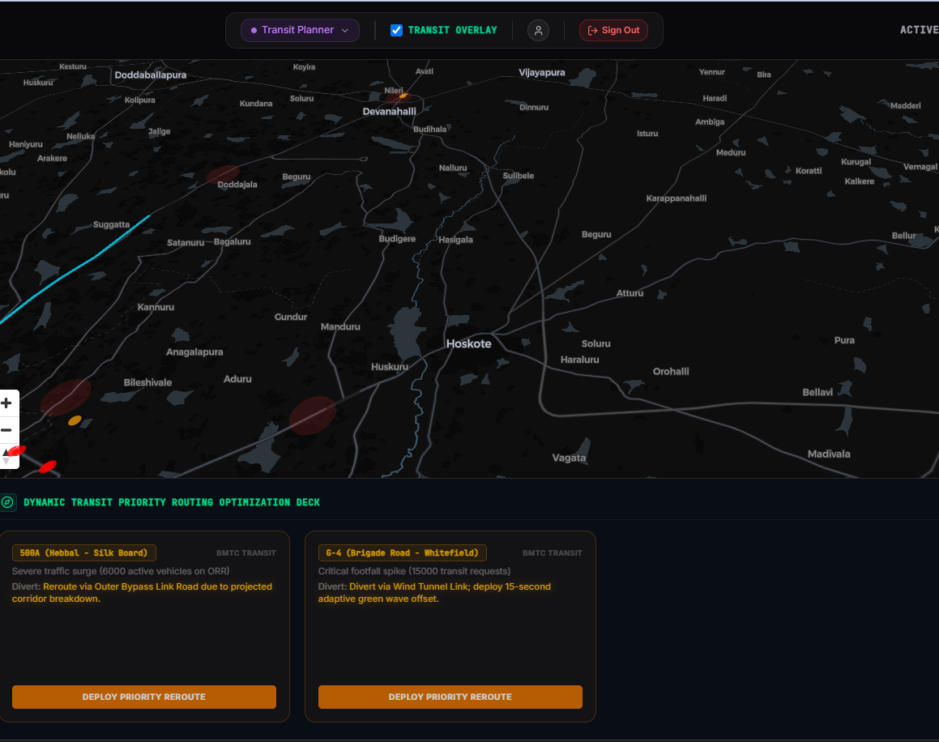
PROTOTYPE INTERFACE
Initial Concept & Command Interface
Real-time Node Visualization & Live Tracking

Slide 7
System Architecture Diagram
Client / Frontend Tier
React
(Web Application)
Deck.gl
(Data Visualization)
MapLibre
(Interactive Maps)
Server / Backend Tier
FastAPI
(REST API & Services)
SQLAlchemy ORM
(Data Access Layer)
AI & Machine Learning Engine
Data Storage Tier
LightGBM
Traffic Models
SHAP Maps
Explainability
Llama 3 SOP
Traffic SOPs
SQLite Local DB

Slide 8
TECHNOLOGIES USED
Frontend UI
Geospatial UI
Backend & Security
React 18 & Tailwind CSS
Fast, responsive component building.
Deck.gl & MapLibre GL
Zero-latency large map rendering.
FastAPI, JWT, Bcrypt, Pydantic
Secure stateless auth & processing.
Database
Predictive AI
Explainable AI
SQLite / PostGIS
Scalable geospatial data storage.
LightGBM Regressor
High-speed CPU-based ETA predictions.
SHAP Framework
Transparent feature weight extraction.
Generative AI
Llama 3 (Local LLM)
Instant plain-text SOP generation.

Slide 9
ESTIMATED IMPLEMENTATION COST
Legacy Enterprise Stack
RESILIO Stack
(The high-cost, traditional approach)
Proprietary Map APIs:~₹200,000 / mo
GPU Cloud Inference:~₹150,000 / mo
Database Licensing:~₹50,000 / mo
TOTAL:~₹400,000 / month
(The high-performance, open-source approach)
MapLibre GL / Deck.gl₹0 (Open-Source Mapping)
LightGBM on CPUs₹0 (Zero GPU Overhead)
Localized PostGIS₹0 (Open-Source Database)
TOTAL: ₹0 (Licensing)

Slide 10

THANK YOU
GRIDLOCK HACKATHON | FLIPKART

